Slide 1

Bridge St, Huntington Rd, Cochran Rd, Thompson Rd Intersection
Richmond Transportation Committee
April 1, 2024
Notes:
Thank you for the opportunity to present our latest report tonight.
We hope that the Selectboard will accept the report so that we can get to work implementing it as part of ongoing efforts to making Richmond safer and more inviting for pedestrians, bicyclists, and motorists.

Slide 2
Richmond Transportation Committee
Established 2019.
Works to improve roads, sidewalks, paths, public transit and services for everyone.
Collaborates with the Selectboard, other town committees, CCRPC, VTrans, Highway Department.
Develops grant applications, designs, plans and public engagement.
2021 Bridge Street Complete Streets Corridor Study
Notes:
RTC is new, established in 2019
Goal: to improve roads, sidewalks, paths, public transit and services for everyone.
We know that getting people out of cars, to walk and bicycle is good for public health and safety, and for the environment. Particularly in the Village, where parking is scarce, it’s also good for business.
The RTC’s efforts are guided by the Town Plan and regional plans and collaborations with….
In its first 4-years, the RTC has had great success securing grants.

Slide 3
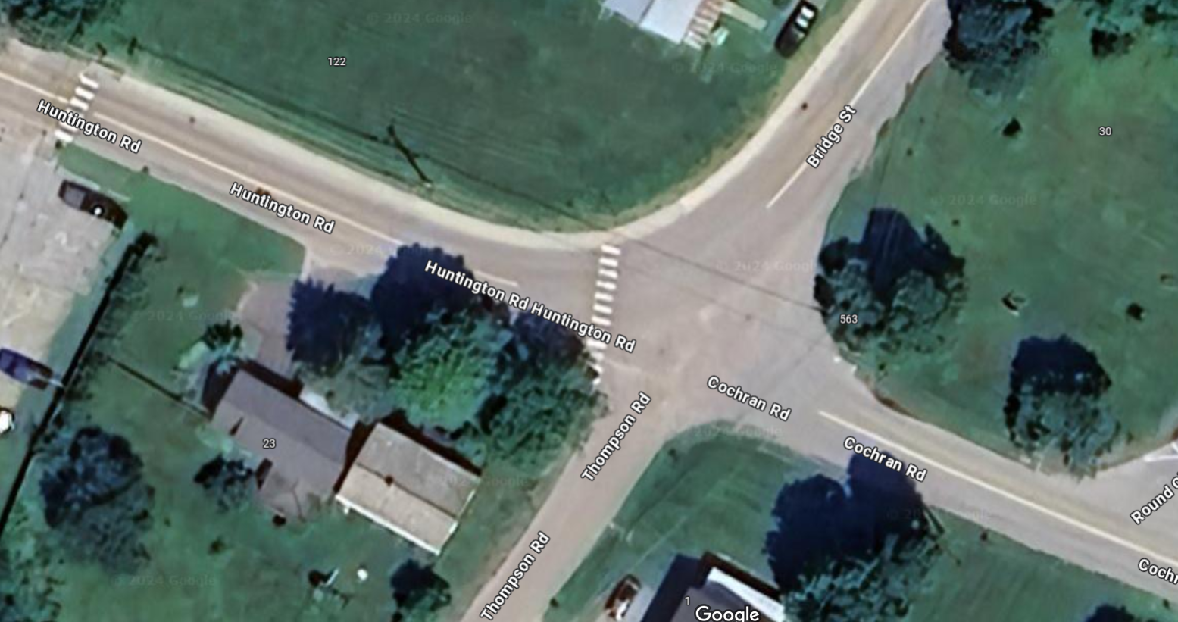
Thompson/Hinesburg/ Bridge/Cochran-Current Design
Chris: We could add, on top of the image, the various problems we’ve identified with the current design (currently listed in the notes below)
Notes:
This intersection is dangerous for motorists, pedestrians, and bicyclists
It lacks clear signage, crosswalks and sidewalks
Many motor vehicles speed through the intersection
Richmond: Bridge Street Complete Streets Corridor Study (CCRPC, VHB, 8/4/2021) developed several alternatives. I am here to discuss two of them.
Our ideal fix is a roundabout, but deemed too costly (~$900,000).

Slide 4
Roundabout—preferred…but too costly
Notes:
Include for perspective?

Slide 5
Alt-1
Four-Way
Stop
Notes:
Four-way Stop offers…
Reduced corner radii to slow turning vehicles turning from Bridge onto Huntington and Cochran onto Bridge;
Crosswalks and Streetlights;
a speed table on Huntington Rd; and,
a sidewalk on the south side of Huntington Rd from the intersection to the Round Church Corners Complex.
Least costly option beside no-build

Slide 6
Four-Way Stop
Least expensive option.
Easily understandable for motorists.
Ensures cars will stop making it the safest alternative for pedestrians and bicyclists.
~5,400 vehicles use this intersection daily. Requires stops 24hrs/day, 365 days/year, including times of day/night and year when few, if any, pedestrians, or bicyclists would be present.
Added noise/vibrations from trucks starting/stopping.
Could further delay the morning commute along Bridge St.
Pros
Cons
Notes:
Four-Way Stop - Pros
Less expensive option.
Easily understandable for motorists
Safest alternative for pedestrians to cross. Ensures cars will stop and pedestrians more visible.
It would most reliably improve pedestrian safety in crosswalks and thereby allow greater pedestrian access, including to the daycare on Thompson Rd, to Richmond Terrace, and to the commercial area on Huntington Rd. This alternative best aligns with the 2018 Town Plan goals for a walkable/bikeable community.
It would “normalize” the intersection to a right-of-way pattern understood by all users, not just locals. This should help reduce the vehicle crash frequency (6 crashes listed between 2015-2019).
It would reduce vehicular speeds in all directions at the intersection.
It would most reliably improve bike safety in the intersection.
In the AM peak hour, the delay/queue on Huntington Rd. would reduce the delay/queue on Bridge St, thus same total time to get through the rate limiting Bridge/US2/Jericho intersection but divided into two segments.
Four-Way Stop - Cons
May be undesirable for through drivers. The Bridge St corridor serves approximately 5,400 vehicles per day. All motor vehicles would be required to stop 24hrs/day, 365 days/year, including times of day/night and times of year when few, if any, pedestrians, or bicyclists would be present.
One neighbor expressed concern regarding the noise of trucks stopping and starting at the stop sign. Other neighbors expressed no concern over trucks and requested the four-way stop.
Vehicle traffic would need to come to a full stop. The report estimates a shorter queue than what occurs on Bridge St. northbound in the morning and on US2 eastbound in the evening and westbound in the morning and is considered in the acceptable range by traffic engineers.

Slide 7
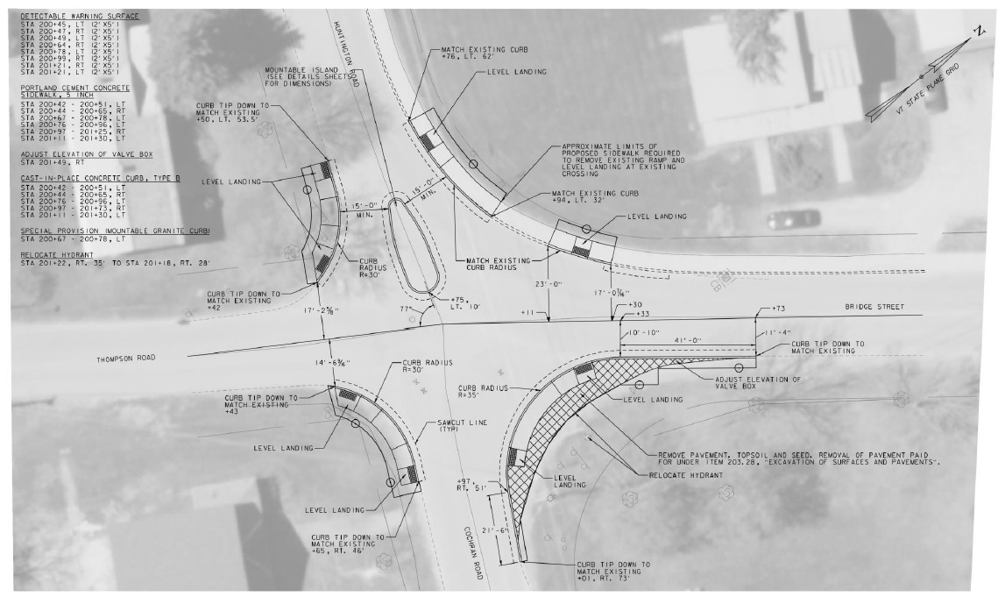
Alt-2
Mount-able Island
Would it help to include a zoom in shot of the intersection/island?
See next slide
Notes:
Mountable Island offers…
Reduced corner radii to slow turning vehicles turning from Cochran Rd onto Bridge St
Crosswalks, Streetlight and Curbs
Sidewalks with ADA ramps
Crossing flashers
A yield sign for left turns from Bridge St onto Cochran Rd
A sidewalk on the south side of Huntington Rd from the intersection to the Round Church Corners Complex.
Consider raising the crosswalks for increased visibility and acting as small speed bumps.

Slide 8
Alt-2
Mount-able Island
Would it help to include a zoom in shot of the intersection/island?
Notes:
Mountable Island offers…
Reduced corner radii to slow turning vehicles turning from Cochran Rd onto Bridge St
Crosswalks, Streetlight and Curbs
Sidewalks with ADA ramps
Crossing flashers
A yield sign for left turns from Bridge St onto Cochran Rd
A sidewalk on the south side of Huntington Rd from the intersection to the Round Church Corners Complex.
Consider raising the crosswalks for increased visibility and acting as small speed bumps.

Slide 9
Mountable Island
Island slows, but does not stop traffic flow between Bridge St. and Huntington Rd.
Sidewalks are helpful for pedestrians waiting to cross: currently no place to stand at some corners.
Squares up the approach from Cochran Rd to Bridge St.
More expensive.
Less effective at protecting pedestrians and bicyclists.
Does not normalize the right-of-way.
Pros
Cons
Notes:
Mountable Island Alternative – Pros
Sidewalks are helpful for pedestrians waiting to cross: currently no place to stand at some corners.
Island is designed to slow down vehicles moving to/from Huntington Rd and Bridge St and from Huntington Rd to Cochran Rd.
Keeps major traffic flowing between Bridge St. and Huntington Rd.
Reduced corner radii squares off the intersection which slows cars down turning to/from Bridge St. and Huntington Rd; and squares up the approach from Cochran Rd to Bridge St.
Slows traffic without stopping it, converts the intersection into shared-use infrastructure, provides enhanced pedestrian safety.
A safety improvement on the current situation in that it would slow (but not stop) vehicles.
It is much less expensive than a signalized intersection or a roundabout.
Mountable Island Alternative – Cons
More expensive than the four-way stop and might still induce right-of-way confusion.
Compared to a four-way stop, it is less effective in improving pedestrian and bike safety and less effective in achieving the 2018 Town Plan goals.
It might not reliably slow traffic going straight through from Huntington Rd. to Cochran Rd.
It does not “normalize” the right-of –way pattern of the intersection. The confusion will remain.
The mountable center island is seen as a problem by some, although a standard VTRANS infrastructure feature.

Slide 10
Cost Estimates
Cost Estimate* | 1: Four-way stop | 2: Mountable Island
Original per VHB | Base Cost: $100,000 | Base Cost: $72,700
Raised Crosswalks | not needed | $2.5k to $8k ea Huntington Rd near Thompson Rd.
Speed table | $2.5k to $8k ea, Huntington Rd near Farr Rd | $2.5k to $8k ea, Huntington Rd near Farr Rd
Sidewalk: THBC to Business Complex | $21,000 to $30,000 | $21,000 to $30,000
Streetlights | $500 ea fixture. One or two recommended | $500 ea fixture. One or two recommended
Crossing flashers | not needed | ~$6.4k per unit. Installation ~$20k-$30k each at locations per engineer’s design
I reported the broken streetlight at THBC to GMP two weeks ago. Once it is working again its possible additional streetlights won’t be needed.
Notes:
these estimates are from multiple sources and distilled to an average cost and adding an additional 15-20% contingency would also be prudent based on current trends. Final costs associated with any project are best arrived at during scoping and design at the time the project is evaluated.

Slide 11
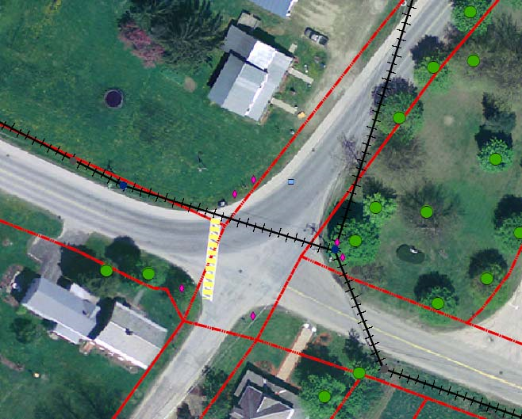
Next Steps
What do you want to offer here?
What can the transportation committee offer
What should be left to the planning office and highway dept?
Ideally replace with an image with happy pedestrians, bicyclists and motorists
Notes:
Thanks to Ravi, KO and CCRPC for their help.

