Slide 1
Potential Affordable Housing Sites in Richmond
Richmond, VT
September, 2023

Slide 2
Affordable Housing
There is a documented need for housing in Vermont. CCRPC’s “Building Homes Together 2.0” campaign set a goal of 5,000 new units in Chittenden county by 2025, with 1,250 being affordable.
The Richmond Housing Committee has been researching how to provide Richmond’s share of affordable housing, primarily by looking towards affordable housing developers such as Champlain Housing Trust and Cathedral Square. These entities are looking for the following for a successful project:
Access to town water/sewer
Walkable to town center with sidewalks
Availability of public transportation, if possible
Minimum of 20 units for financial viability
Community support
Ownership and management of the land/project

Slide 3
Affordable Housing
There may be alternatives for smaller scale projects, such as Habitat for Humanity or other grant programs, that exceeded the scope of our current research.
The following four areas were assessed for their potential for developing affordable housing. Contacts with owners were informal at this stage without Town commitment.
The subsequent two areas were suggested by our housing consultant, Brandi Saxton, but have not yet been fully evaluated.

Slide 4
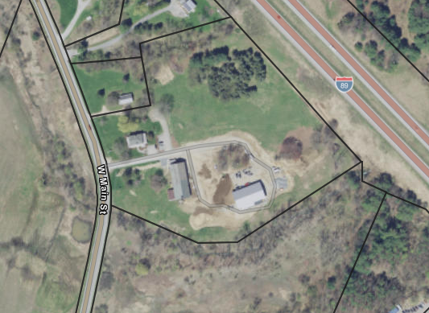
Willis Farm-Gateway
Contiguous to village | X | not contiguous, but near the village and school properties
Walkable/sidewalks | X | investment needed to build infrastructure. Sidewalks could be built along Rt 2 or from School St. -- VTrans and Cemetery may be barriers
Water/sewer | X | investment needed to build infrastructure, have easement from Richmond Land Trust which may be able to serve additional properties
Zoning allowance | +/- | current Gateway R/C zoning density allows 1 dwelling unit per 5,000sfl (approximately 8 U/A). A 2.5 A parcel would be required for 20 dwelling units. Increased density would require zoning change.
Owner Interest (initial conversations) | X | open to developing market-rate housing, not interested in selling land or developing affordable housing at this time.
Neighborhood support | - | unknown
Next steps | - | Town incentivizes affordable housing or buys parcel if owner becomes interested
Details:
10-acre parcel
Owned by Reap family
Bordered by I-89, Rt. 2, residential parcels and Richmond Land Trust conserved property

Slide 5
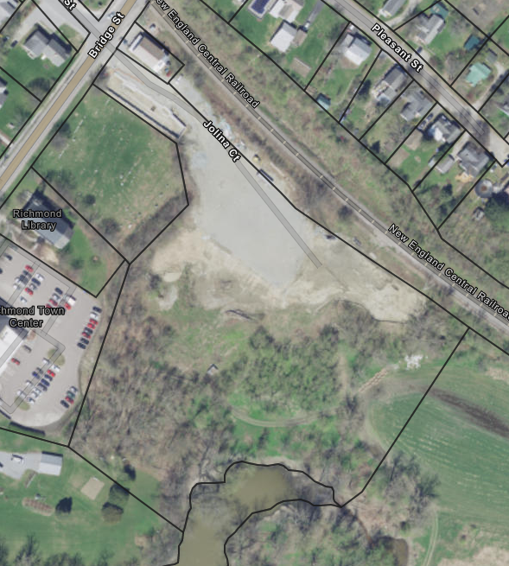
Jolina Court/ Buttermilk Development
Contiguous to village | + | within village
Walkable/sidewalks | + | internal sidewalks planned. Town will connect to existing and new Town sidewalks.
Water/sewer | + | allocation approved.
Zoning allowance | +/- | currently 15 U per developable Acre (which is approximately 7.5 U/A) Increased density to allow >45U total would require zoning change.
Owner Interest | X | interested in developing market-rate housing, not interested in affordable housing or selling/leasing to affordable housing entity
Neighborhood support | - | unknown
Next steps | - | Previous town planner reached out, but attempt failed. Likely now must be owner-initiated.
Details:
6-acre parcel (½ of property is in flood plain)
Currently have 14 housing units in Building 1
Have approved plans for 31 dwelling units in Building 2 (application for phase 2 approved by DRB)

Slide 6
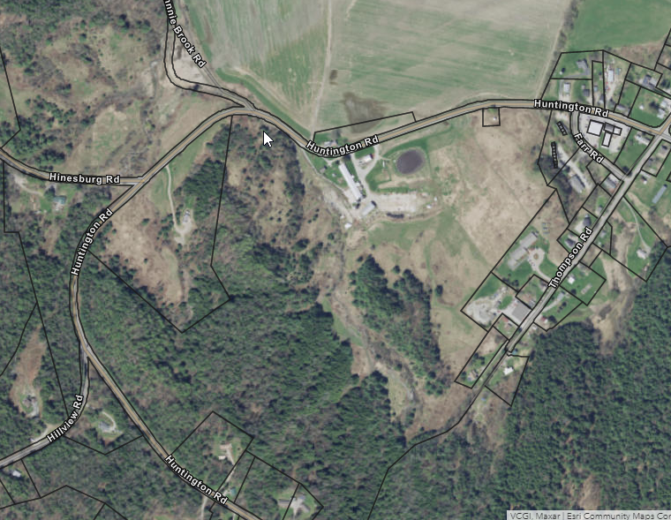
Farr Farm
Contiguous to village | + | south of village
Walkable/sidewalks | + | investment required, but could be extended from existing sidewalk
Water/sewer | + | investment required, but could be extended from existing service area
Zoning allowance | X | current zoning 1 U/A. Rezoning of property would be needed with increased density and uses change
Owner Interest | X | no current interest in development, may be interested in more on-farm business opportunities or master planning for deep future
Neighborhood support | - | unknown – many in village enjoy walkable local farm
Next steps | - | more formal engagement with owners and significant research would be needed if any interest is shown. Owners currently are invested in continuing to farm.
Details:
30A area of 300+A Farr property
Currently farmed, and contiguous to area of farmland in floodplain

Slide 7
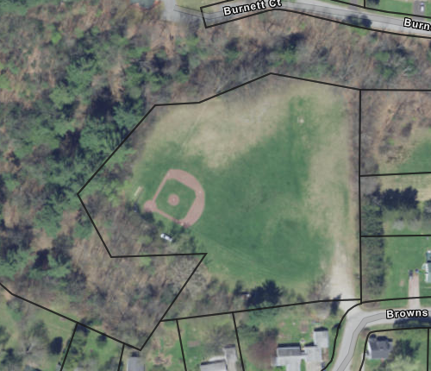
Browns Court
Contiguous to village | + | within village
Walkable/sidewalks | + | investment required, could be extended from existing
Water/sewer | + | investment, but could be extended from existing
Zoning allowance | X | Current zoning allows 1.3 U/A. Rezoning to increase density to 5 U/A is planned, but a further increase would be needed as well as a uses change
Owner Interest | +/x | Town is interested in developing affordable housing, but also has conflicting interest in recreational and open space
Neighborhood support | X | All neighbors have expressed opposition to development. Increasing density and lot coverage requirements in village will require more public open space for livability
Next steps | - | Significant conversations among neighbors, Planning Commission, Housing Committee, Recreation Committee, stormwater management professionals and Selectboard would be needed to establish best/desired use of this property
Details:
4 acre parcel
Town owned land, currently a park/field

Slide 8
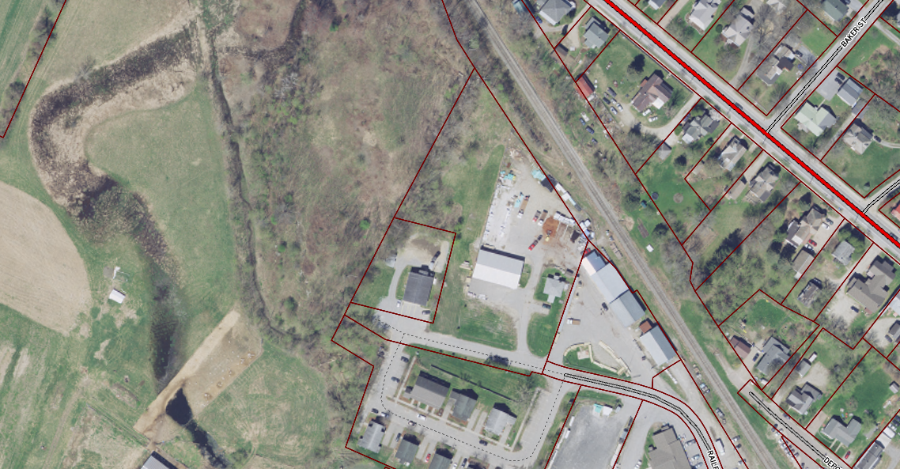
Railroad Street Extension
Contiguous to village | + | within village
Walkable/sidewalks | + | investment needed for infrastructure but could be developed
Water/sewer | + | could be extended from existing
Zoning allowance | X | would need zoning changes for density and uses
Owner interest | X | parcel currently subdivided into lots for commercial use and owner interested in zoning district which does not allow residential uses
Neighborhood support | - | unknown
Next steps | - | Discussions with owner and further consideration by Planning Commission as to how to balance residential and commercial needs
Details:
About 3 A of undeveloped land
at the end of Railroad St
Currently zoned Village Commercial
with density of 3 U/A
Owner has planned for commercial
development

Slide 9
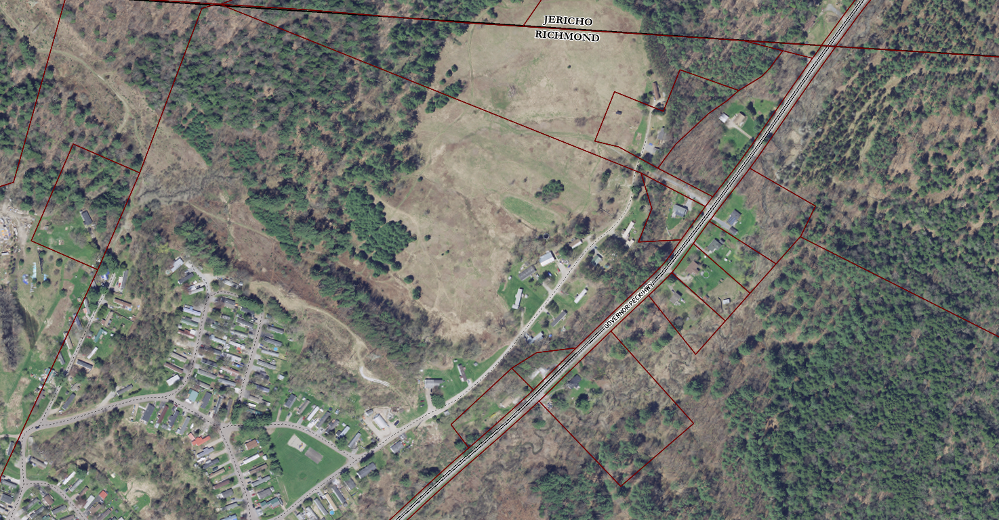
Riverview Commons
Contiguous to village | X | 1 mile away
Walkable/sidewalks | X | Efforts to connect with village center in planning phase – unlikely to happen soon
Water/sewer | X | Not connected to municipal water and sewer service, and efforts to connect have failed at this time, but owner says current community system could supply new units
Zoning allowance |  | Current zoning allows 4 U/A for mobile home sites, and 1 U/A for non-park lots in the district, which will need to change to 5 U/A – rezoning would be needed for greater density
Owner interest |  | Owner has expressed interest in increasing number of home sites in park
Neighborhood support | - | unknown
Next steps | - | further research and discussions with owner
Details:
2 parcels totaling 108 A of
which +/- 50A is undeveloped
Owner has indicated that he has
plans to add 65-85 additional home sites
Density currently 1.4 U/A – with
additional would be 2.2 U/A

Slide 10
Conclusions
1. “Traditional” affordable housing projects, as developed by affordable housing entities such as Champlain Housing and Cathedral Square, generally require the conditions listed on slide 2 of this presentation, as well as interest by the property owner.
2. Richmond is limited in open space contiguous to needed amenities to make such projects feasible.
3. None of the options that were identified within the Richmond water and sewer service area that were large enough to host a traditional affordable housing project seem feasible or likely at this time.
4. Expansion of the Mobile Home Park seems most likely to increase supply of affordable housing from these options.
5. Small number of Housing Committee members currently hinders new initiatives.
6. Lack of incentivization is an impediment to AH

Slide 11
Potential Next Steps for the RHC
1. Refocus on identifying possible affordable housing strategies outside the water and sewer area while balancing climate goals.
2. Refocus on promoting “non-traditional” affordable housing strategies in the water and sewer area such as “missing middle” housing, Habitat for Humanity etc.
3. Focus on identifying strategies for increasing housing that is affordable rather than “affordable housing” (such as more multiunit housing, duplexes, increase size of ADU’s from 1k, smaller lots)
4. Discuss serious commitment by Town (that is, Selectboard) to incentivize affordable housing or consider identifying and purchasing land.
5. Research USDA Rural Development program or other housing programs or grants
6. Increase membership of the Housing Committee.

