Slide 1
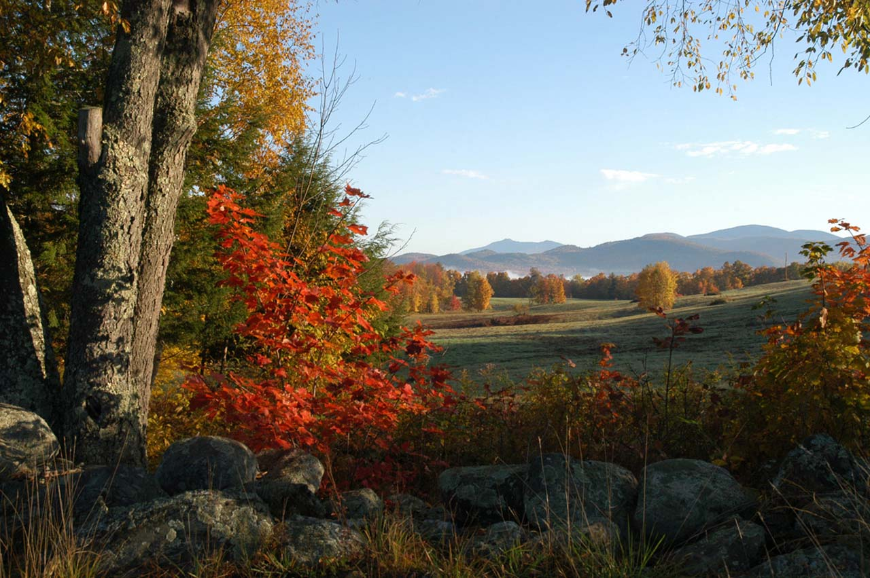
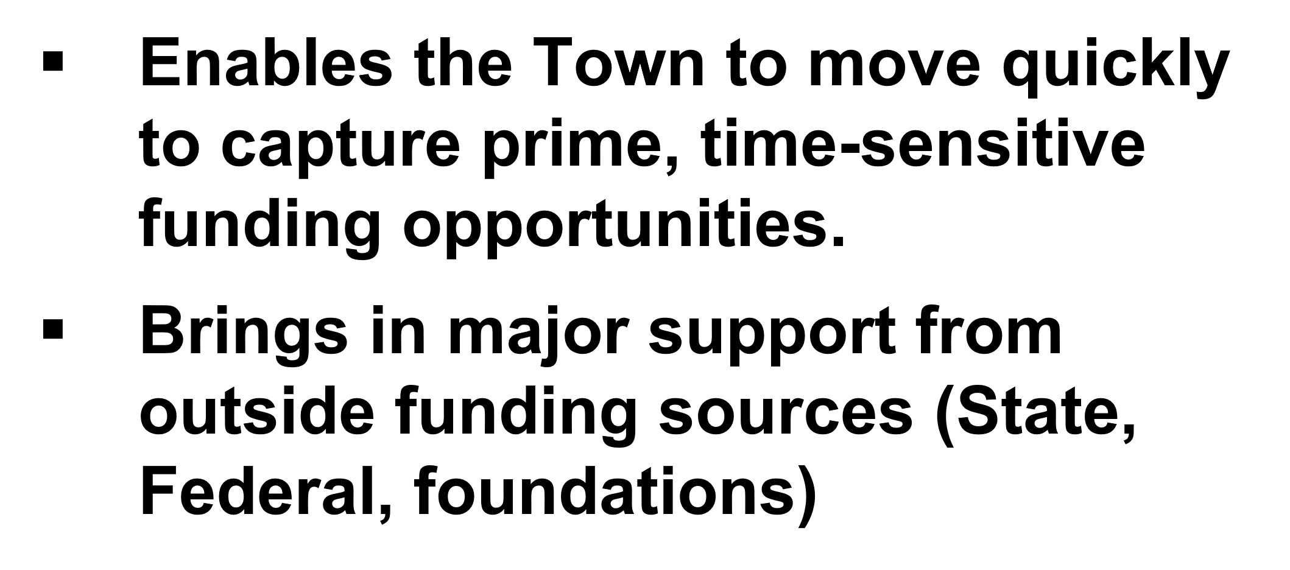
Renewing Richmond’s
Conservation Reserve Fund
Draft
An 18-year successful track record at protecting water and air quality, biodiversity, working farms and forests, outdoor recreation, historic resources and education.
Established by voters 2005
Last Renewed by voters 2023 (Yes – 560; No – 201)
Has brought in over $2.0 Million in outside support

Slide 2
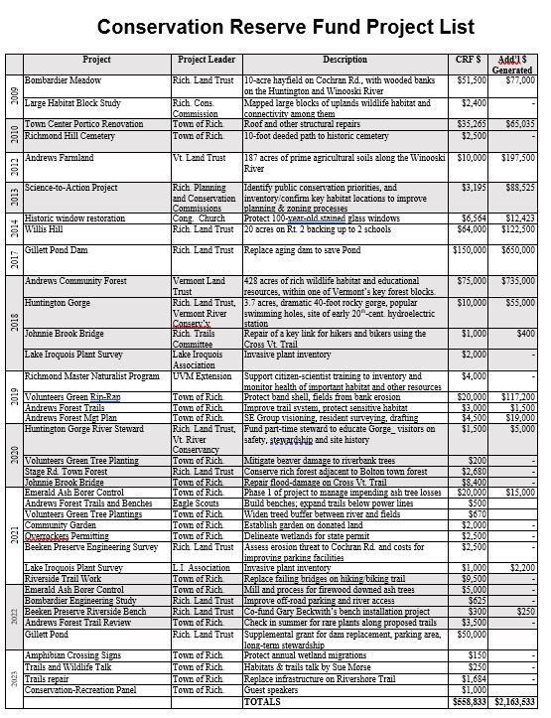
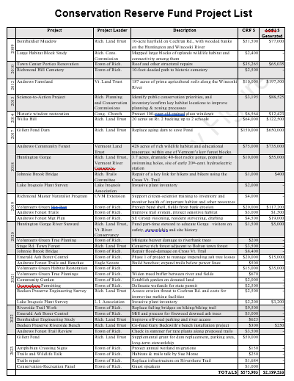
Information Sheet
GOTO Town Website: Conservation Commission

Slide 3
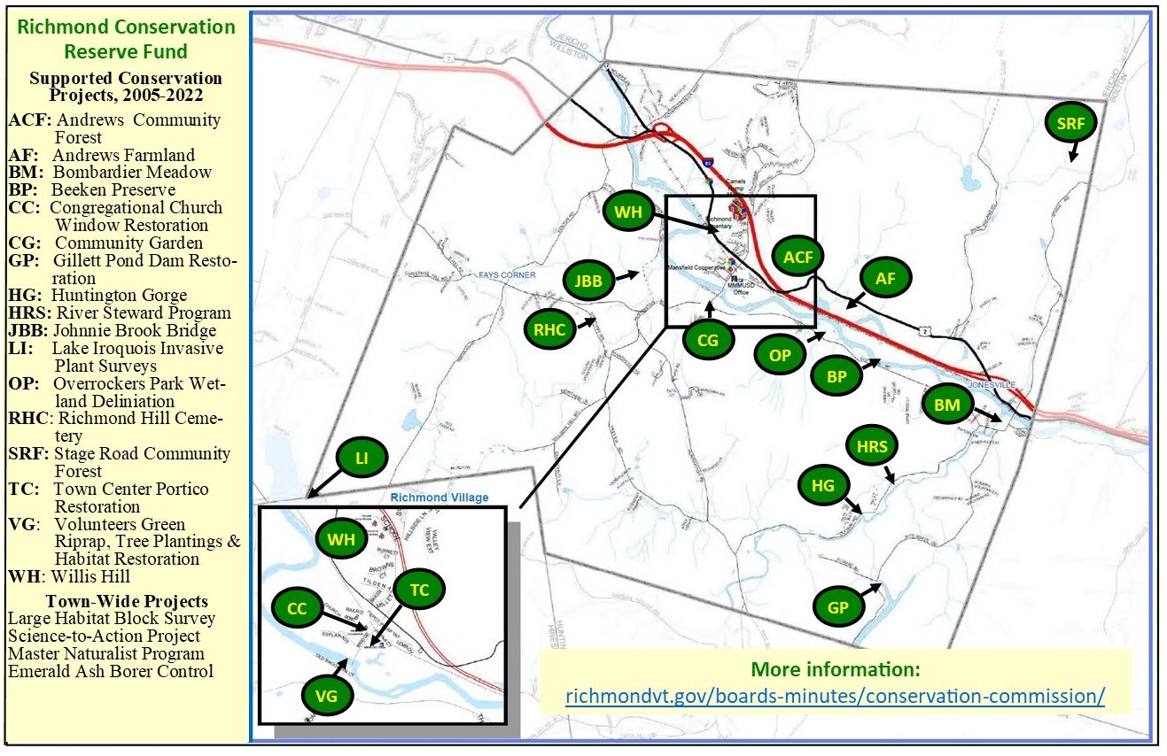
CRF-Funded Projects
Recent Projects
Conservation / Recreation Panel
Sue Morse trails & wildlife talk
Trails Repair
Gillett Pond Supplement
Amphibian Crossing
GOTO Town Website: Conservation Commission

Slide 4
The CRF Advances Town Plan Priorities
“Protect priority natural areas in order to maintain the health and function of those areas and their ecosystem services.”
“Preserve healthy and resilient working lands, agricultural soils.”
“Maintain Richmond’s rural character and scenic beauty.”
“Utilize best management practices for Richmond-owned, publicly accessible natural and recreational areas.”
“Utilize the conservation reserve fund to protect important
natural resources and public access to them where appropriate”

Slide 5
3.8X Return on Taxpayer Funding
To date:
CRF grants: $ 575, 903
Additional $ generated: $2,199,533
Leverage: $1 CRF brought in $3.82
3.8X
Notes:
5

Slide 6
Need Out There
Andrews Community Forest
Winooski River
Trail Repair – Flood damage
Town Center Greenscaping
VT’s 30x30 Legislation

Slide 7
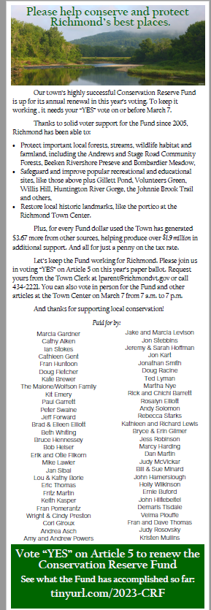
A Popular Tool for Local Conservation
Consistent voter support since 2005
Last year, over 60 residents chipped in for and signed a Times Ink! ad supporting CRF renewal
More than 70% of voters supported renewal of the CRF and its funding method

Slide 8
The Question on Australian Ballot
Funding mechanism remains the same
Article 13: Shall the Town of Richmond vote to approve funding the Conservation Reserve Fund by adding one cent to the municipal tax rate in the 2024-2025 fiscal year? (To be voted by Australian ballot)
2022: Yes – 839 No – 245
2023: Yes – 560 No – 201

Slide 9
Questions / Comments?
Judy Rosovsky, RCC Chair: Judy.Rosovsky@vermont

