Slide 1
Richmond Village Scoping Study Cochran Road Corridor Study
TUESDAY, APRIL 9, 2024
5:30 PM

Slide 2
Agenda
Project Overview
Project Team Introduction
Project Goals
Project Limits/Locus Map
Planning Context
Existing Conditions
High level overview
Roadway and Sidewalk elements
Intersection overview
Discussion of Opportunities and Concerns

Slide 3
Project Team
Jason Charest, PE, PTP
Senior Transportation Planning Engineer
Erik Maki, PE, PTOP
Senior Director, Traffic Engineering
Kevin McCarthy, PE
Senior Transportation Engineer
Annabelle Dally
Communications & Public Involvement Manager
Zachary Gavel
Transportation Planner

Slide 4
Project Context
Scoping Study – Village centers; Richmond and Jonesville.
Corridor Study – Cochran Road; build on the recommendations and alternatives presented in the Town of Richmond Bike, Walk, and Trails Plan.
Traffic Calming – evaluate the temporary traffic calming measures and recommend permanent traffic calming solutions.

Slide 5
Project Goals
Identify new infrastructure such as sidewalks that can be incorporated into the village centers.
Identify specific on-road and off-road improvements and multi-modal strategies that address safety, capacity and connectivity for pedestrians and cyclists on Cochran Road.
Evaluate the study on temporary traffic calming measures and recommend permanent traffic calming solutions.

Slide 6
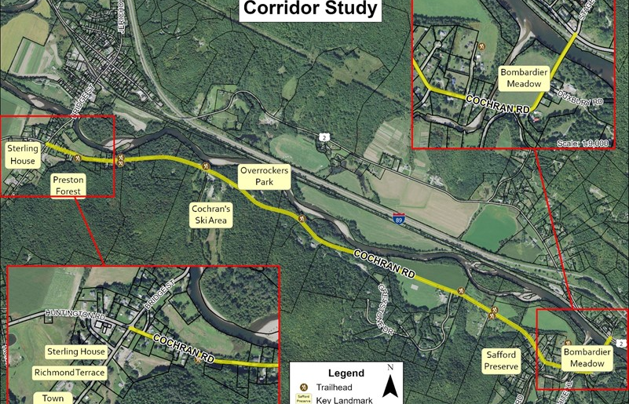
Study Area
N
Project Limits:
Richmond Village
Jonesville
Cochran Road
A
C
B

Slide 7
Review of Previous Studies
2022 Richmond BIKE.WALK.TRAILS Plan
Evaluate options to improve:
traffic Calming
safety
bicycle/pedestrian connectivity

Slide 8
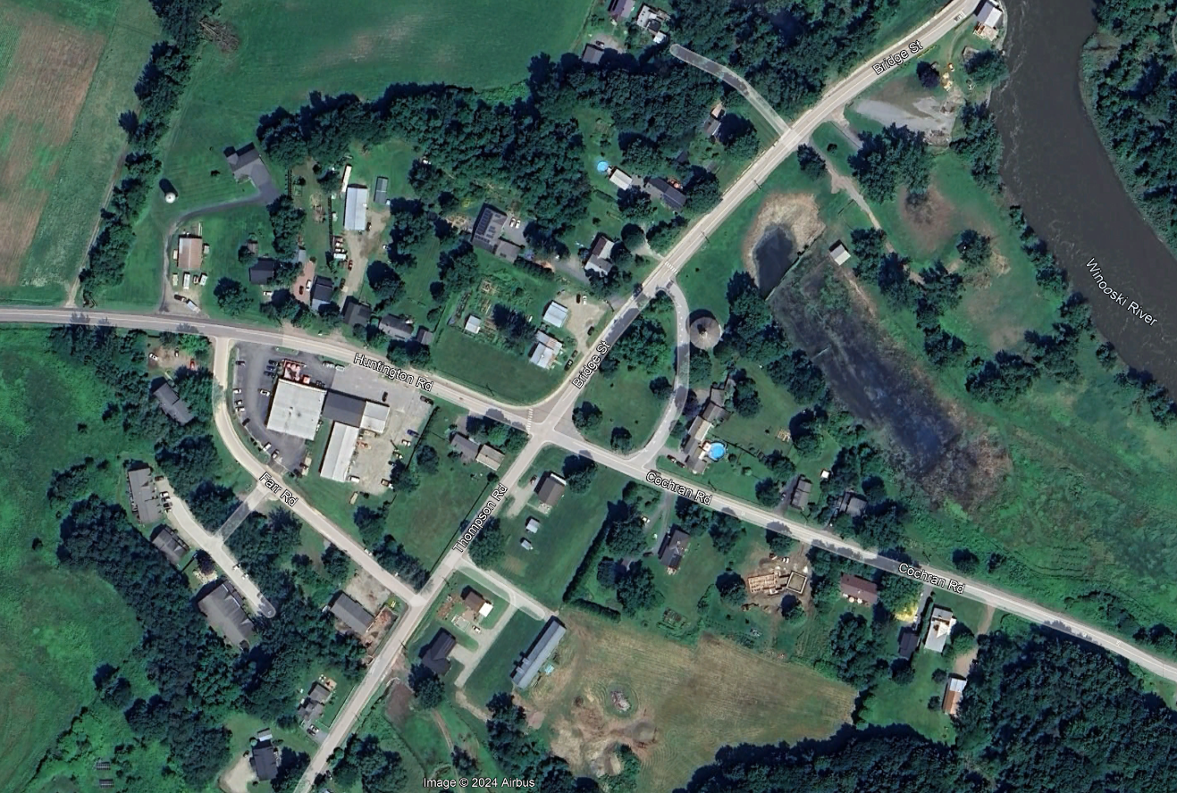
Existing Conditions – Richmond Village
N
X
Y

Slide 9
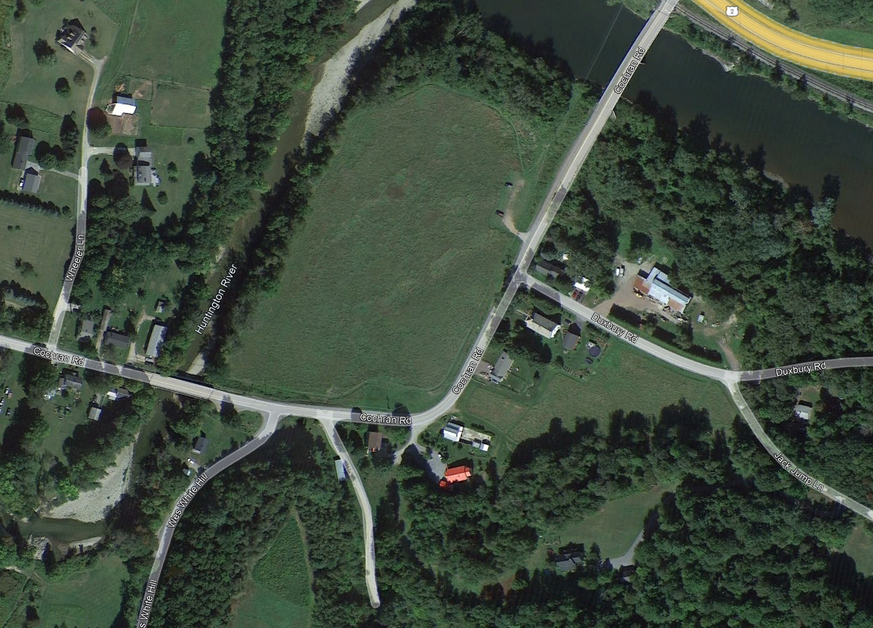
Existing Conditions – Jonesville
N
X
Y

Slide 10
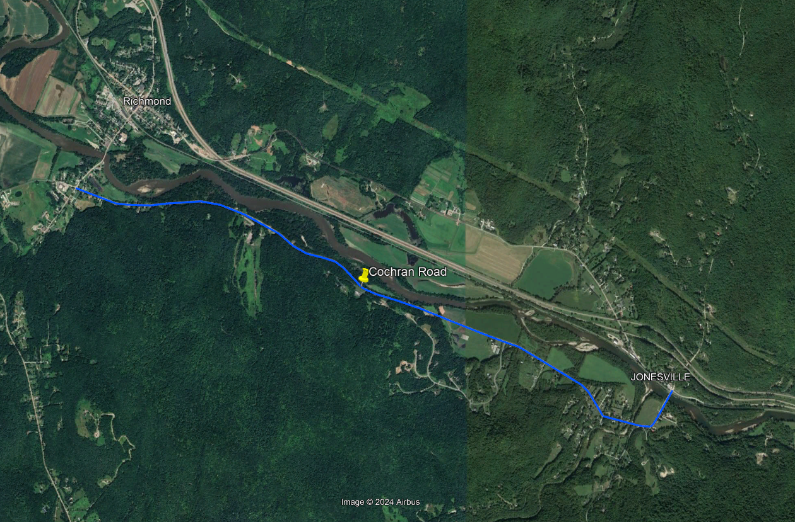
Existing Conditions – Cochran Road
Right of way: +/- XX feet
Pavement width: +/- XX feet
AADT (20XX) :
Daily total – x,xxx vehicles per day
Northbound – x,xxx vehicles per day
Southbound – x,xxx vehicles per day
Speed limit – XX miles per hour
N
Text
Text

Slide 11
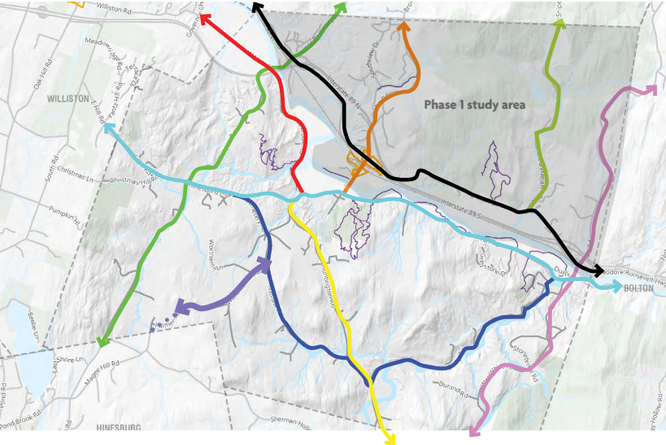
Study Area – Major Travel Corridors
N

Slide 12
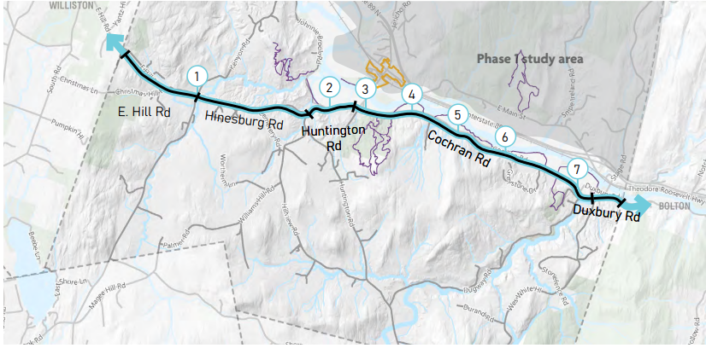
Places & Trails – Cochran Road
1 Fays Corner
2 Johnnie Brook Trail
3 Huntington, Cochran, Thompson, Bridge St Intersection; Farr Complex
4 Preston Forest Legacy & River Trail Access; Trail Crossing
5 Cochran’s Ski Area & Trails
6 Overocker & Beeken Rivershore Parking
7 Bombardier Meadow; Trail Crossing
N

Slide 13
Public Feedback

Slide 14
Discussion
N
1. Pedestrians
2. Cyclists
3. Shared Paths, connections
4. Parking
5. Safety
6. Traffic Calming
A
C
B

Slide 15
Next Steps – how to stay involved
Project Introduction – March 26, 2024
Task 1. Local Concerns Meeting – April 9
Task 2. Village Scoping Study – (April – June)
Task 3. Traffic Calming Priorities – (July – August)
Task 4. Cochran Road Corridor Study – (August – September)
Task 5. Study Recommendations – (September – October)

Slide 16
Contact Us!
Jason Charest, PE, PTP
Senior Transportation Planning
Engineer
CCRPC
(802) 861-0127
jcharest@ccrpcvt.org
Kevin McCarthy, PE
Senior Transportation Engineer
WSP USA
(617) 531-8178
Kevin.McCarthy@wsp.com
Annabelle Dally
Communications & Public Involvement Manager
WSP USA
(802) 825-2555
Annabelle.Dally@wsp.com
https://ccrpcvt.org/Cochran Road
Notes:
Jason Charest, PE, PTP (he/him)
Senior Transportation Planning Engineer
Chittenden County Regional Planning Commission
110 West Canal Street, Suite 202
Winooski, VT 05404
(802) 861-0127
www.ccrpcvt.org
Annabelle Dally
Senior Consultant, Communications & Public Involvement | US
Northeast Region
T+ 1 603 263-8865
M+ 1 802 825-2555
Kevin McCarthy, PE
Senior Traffic Engineer
T: (617) 531-8178
100 Summer Street, 13th Fl
Boston, MA 02110
wsp.com

Slide 17
Supplemental Slides

